Slide 1
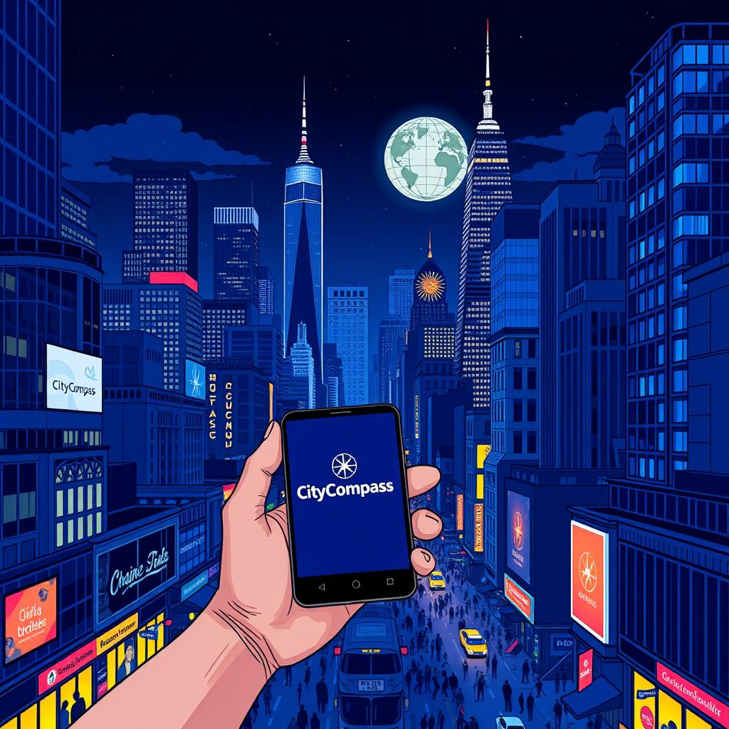
WELCOME
To Our Presentation

Slide 2
“CityCompass”
Explore the World
Welcome to the presentation of CityCompass, your digital guide to city adventures. CityCompass is a Java-based application designed to simplify city exploration by providing well-organized information about accommodations, attractions, and local marketplaces.

Slide 3
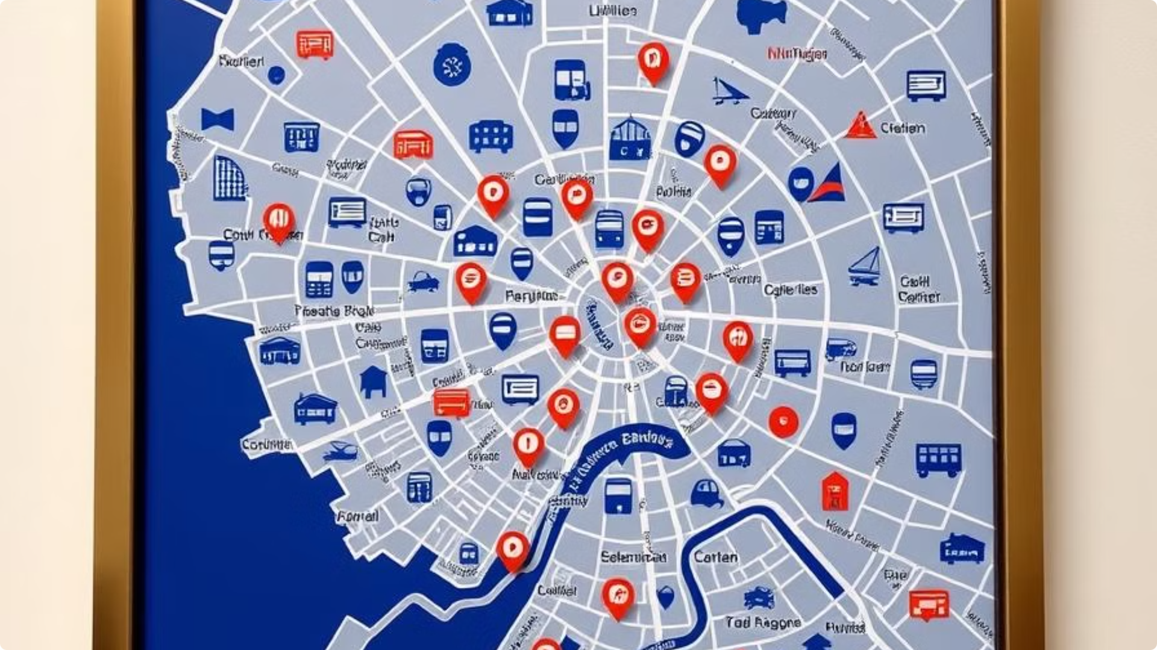
Introduction
CityCompass offers a user-friendly interface with selected information for popular cities. It's designed with scalable and reusable code, making it easy to add new features and cities in the future.
Easy-To-Use Interface
CityCompass prioritizes user experience with a simple and automatic interface.
Scalable and Reusable Code
Organized Information
The application provides carefully selected information for popular cities, ensuring relevant and valuable content.
CityCompass is built with a modular design, allowing for easy expansion and integration of new features and cities.

Slide 4
Introduction
CityCompass offers a user-friendly interface with selected information for popular cities. It's designed with scalable and reusable code, making it easy to add new features and cities in the future.
Easy-To-Use Interface
CityCompass prioritizes user experience with a simple and automatic interface.
Scalable and Reusable Code
Organized Information
The application provides carefully selected information for popular cities, ensuring relevant and valuable content.
CityCompass is built with a modular design, allowing for easy expansion and integration of new features and cities.

Slide 5
1
OBJECTIVES
1. Simplify City Exploration
Provide organized information about accommodations, attractions, and markets for each city.
3. Build a Scalable and Modular Design
Provide organized information about accommodations, attractions, and markets for each city.
4
2
2. Create a User-Friendly Interface
Develop an automatic, visually appealing GUI with easy navigation.
4. Error-Free and Reliable Experience
Implement exception handling to validate inputs and ensure error-free operations.
3

Slide 6
OBJECTIVES
1. Simplify City Exploration
Provide organized information about accommodations, attractions, and markets for each city.
3. Build a Scalable and Modular Design
Provide organized information about accommodations, attractions, and markets for each city.
1
2
4
2. Create a User-Friendly Interface
Develop an automatic, visually appealing GUI with easy navigation.
4. Error-Free and Reliable Experience
Implement exception handling to validate inputs and ensure error-free operations.
3

Slide 7
OOP Principles Applied
Encapsulation
Inheritance
Polymorphism
Sensitive data like user name and email are stored securely in private fields within the SignUp class. Controlled access through public getter methods ensures data safety.
The City class serves as a base for city-specific subclasses (Istanbul, Dhaka, Kathmandu). Allows reuse and extension of the base class structure for consistency.
Subclasses override methods like getAccommodationDetails to provide city-specific information. Enables a single method to work differently for each city.
Abstraction
Exception Handling
Abstract methods in the City class define a framework for all subclasses. Focuses on essential functionality while hiding implementation details.
The SignUp class validates user inputs (e.g., ensuring names are not empty and emails are properly formatted). Errors like invalid inputs are caught and displayed as clear messages, ensuring smooth user interaction.

Slide 8
Member-Based Work Distribution
The CityCompass team has a clear division of responsibilities, ensuring efficient development and a well-rounded application.
ATIKA AKTER MITU
ARAFAT RAHMAN
JAWAD-UL-KARIM
MEHERAB HASAN SABIT
Responsibilities
Responsibilities
Responsibilities
Responsibilities
Developed the SignUp system, including input validation and exception handling.
Created the abstract City class.
Implemented sub-classes with details for specific cities
Created Main Application
(CityCompass) with GUI creating a user-friendly GUI to explore Cities

Slide 9
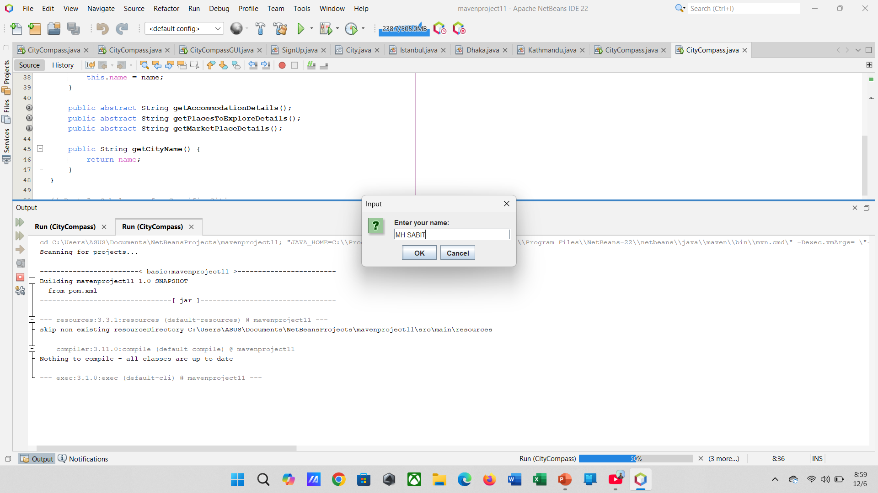
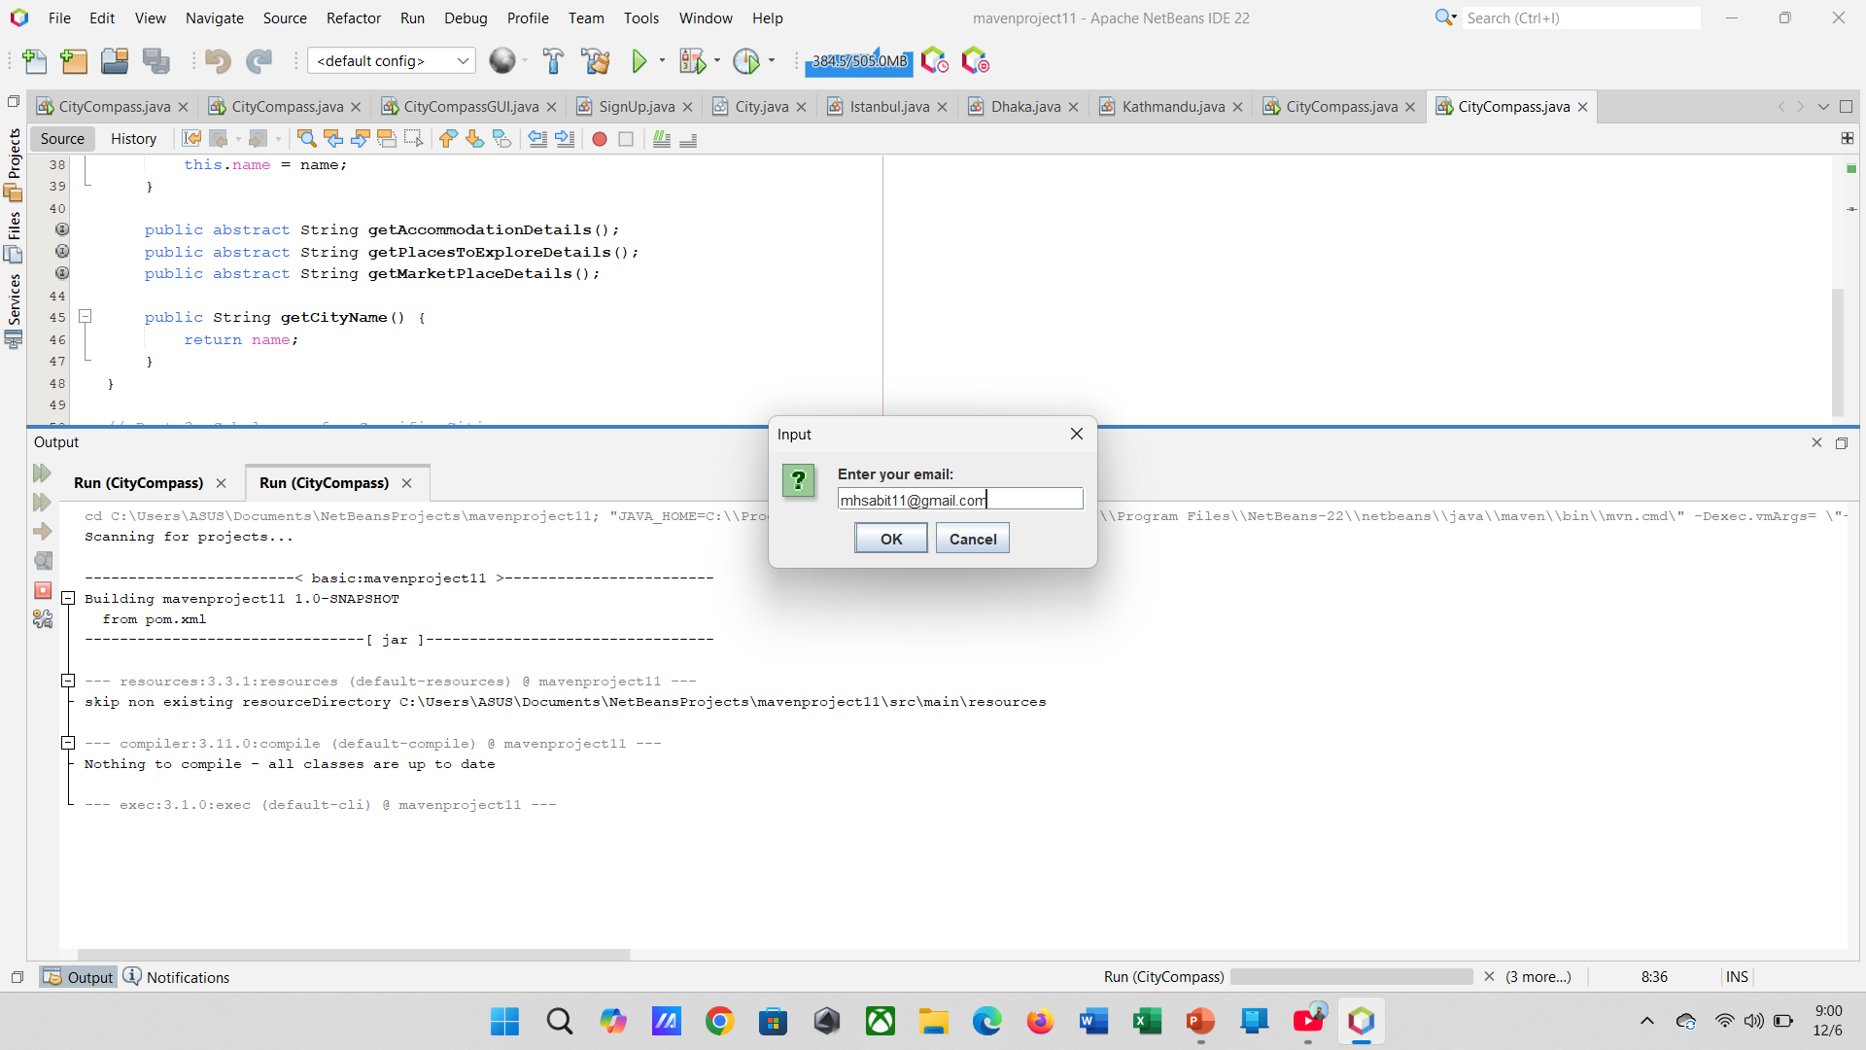
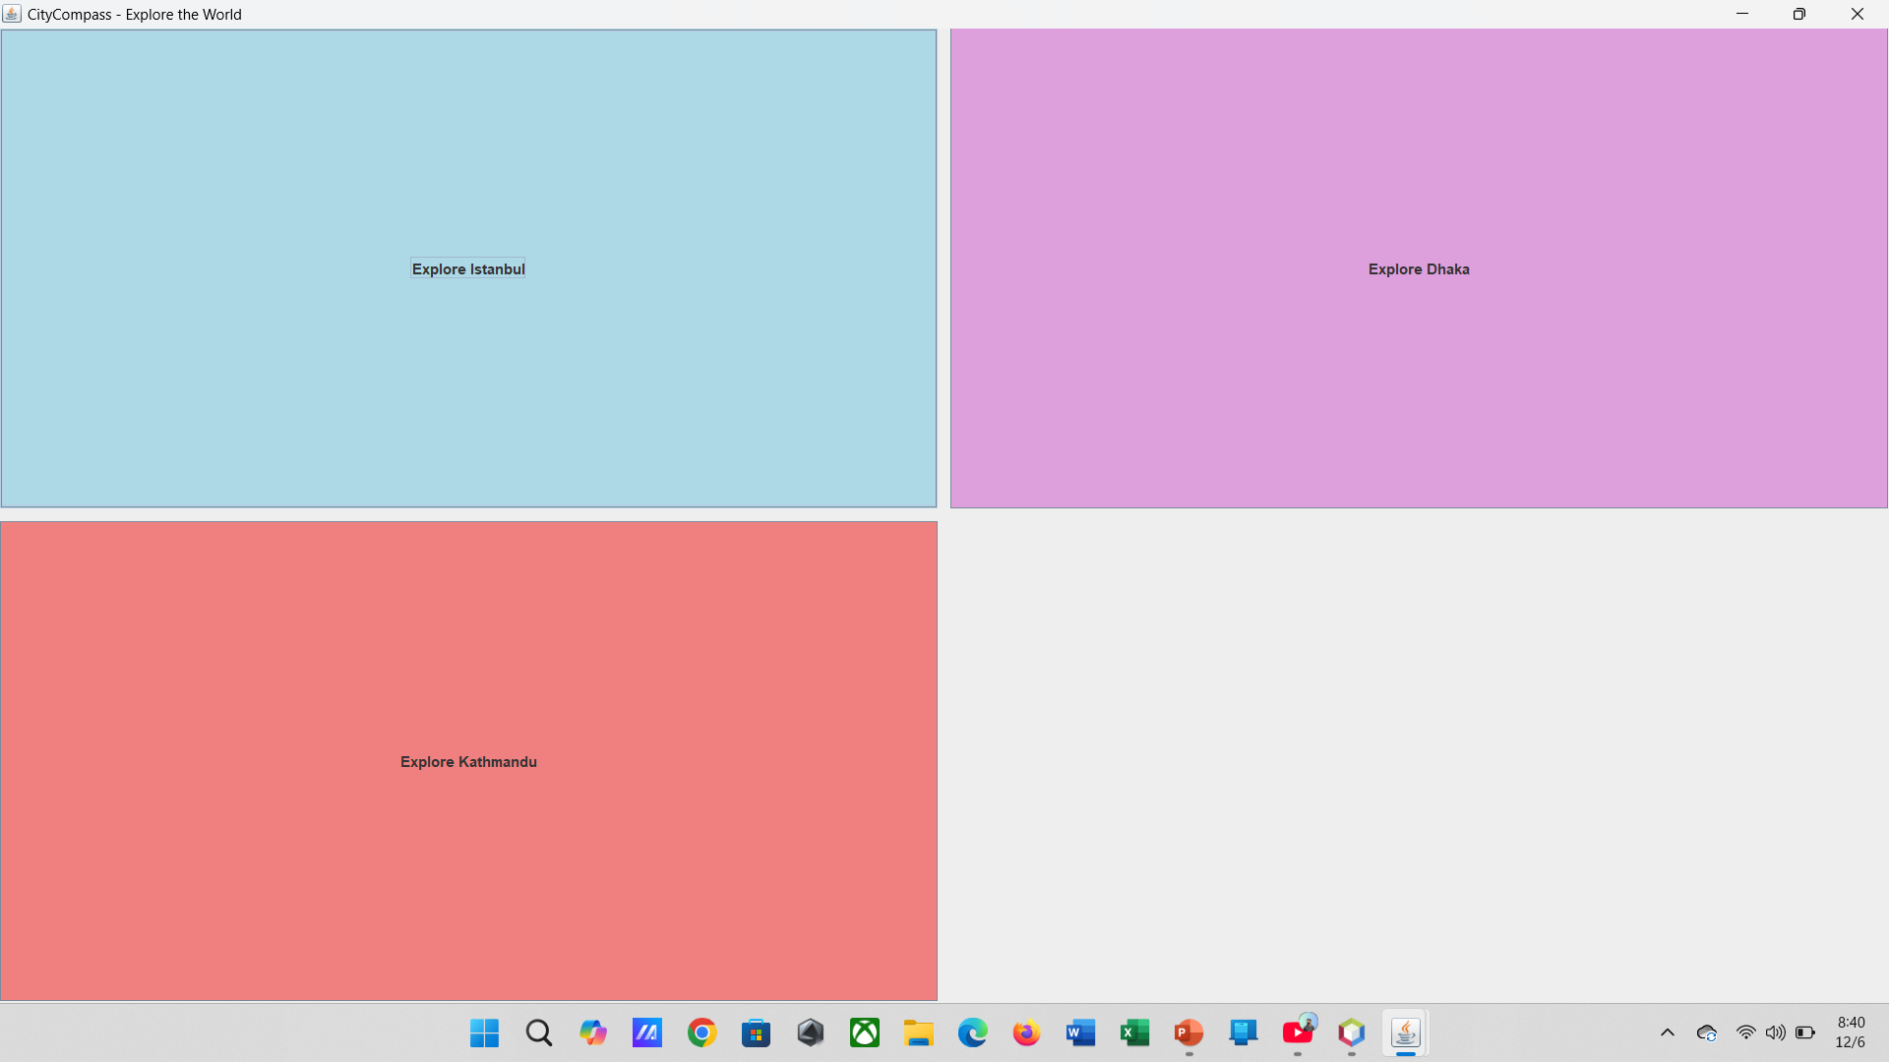
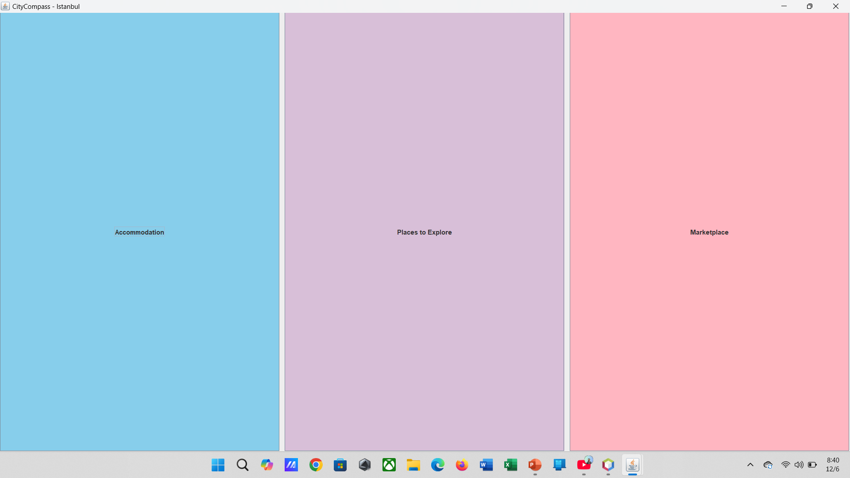
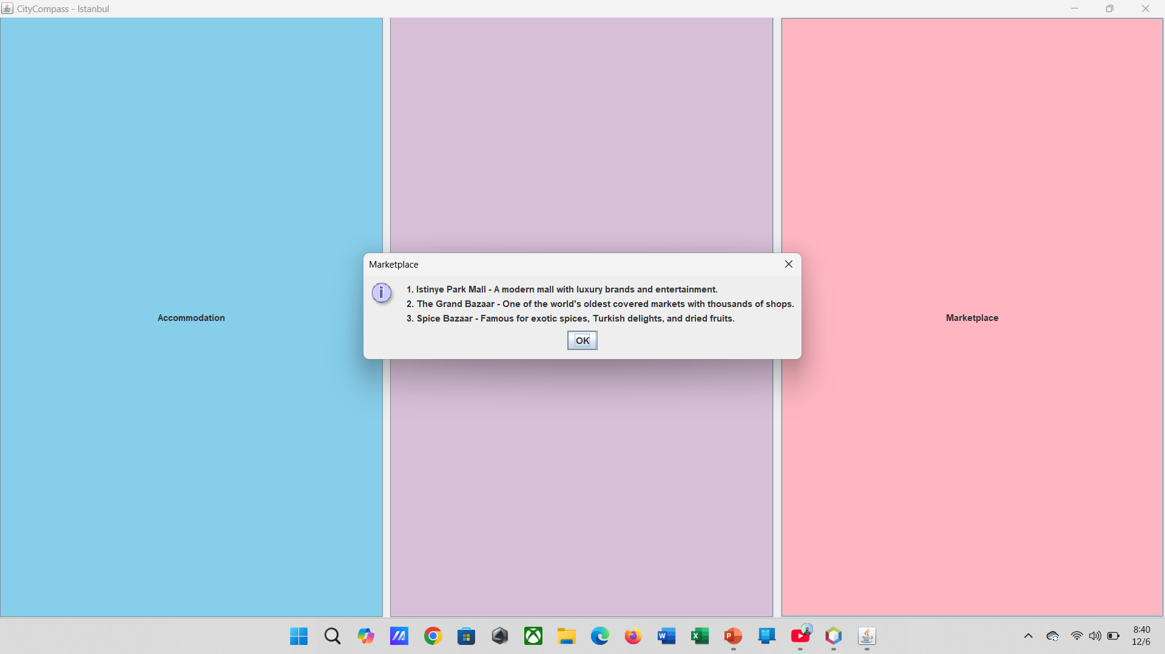

GUI EXPERIENCE
1. Request for Name: After Running the application, the program prompts the user to "Enter your name" in a pop-up input dialog.
2. User Input: The user enters their name (e.g., "MH SABIT") into the input field, as shown in the first image.
3. Action after Input: Once the user clicks the "OK" button, the program processes the input and stores the name for later use, such as for display or further processing.

Slide 10
GUI EXPERIENCE
1. Request for Email: Following the name entry, the program now requests the "Enter your email" in another pop-up input dialog.
2. User Input: The user types their email (e.g., "mhsabit11@gmail.com") into the input field, as shown in the second image.
3. Action after Input: Once the user clicks "OK," the program will store the email, which might be used for registration, login, or other related actions.

Slide 11
GUI EXPERIENCE
In this tab the application wants User to Select a CITY from the given options.
And after the selection of city it will provide a new interface tab .

Slide 12
GUI EXPERIENCE
Once the user selects the city the application open new tab for selecting the services.
In this tab the Application wants User to select the services like Accommodatio, Place to Explore or Marketplace.
Once the User Select the service the application will pop up a new tab.

Slide 13
GUI EXPERIENCE
When the User select a service the application take the user to the final tab .
This time the app pop up a tab with the selected Information of that Selected City on that specific Service (e.g. Marketplace ).
After that the user tap on “OK” and the application run successfully.

Slide 14
Results
CityCompass has achieved significant milestones, delivering a fully functional and interactive GUI, seamless user registration with input validation, and a modular and scalable codebase for future expansions.
Modular and Scalable Codebase
Seamless User Registration
Fully Functional GUI
CityCompass is built with a modular design, making it easy to add new features and cities in the future.
The application includes a secure and reliable user registration system with input validation.
CityCompass provides a user-friendly and interactive interface for exploring cities.

Slide 15
Results
CityCompass has achieved significant milestones, delivering a fully functional and interactive GUI, seamless user registration with input validation, and a modular and scalable codebase for future expansions.
Modular and Scalable Codebase
Seamless User Registration
Fully Functional GUI
CityCompass is built with a modular design, making it easy to add new features and cities in the future.
The application includes a secure and reliable user registration system with input validation.
CityCompass provides a user-friendly and interactive interface for exploring cities.

Slide 16





Future Improvements
CityCompass has a promising future with plans for continuous improvement and expansion. The team is committed to enhancing the user experience and providing a comprehensive digital city guide for travelers.

Slide 17
Future Improvements
CityCompass has a promising future with plans for continuous improvement and expansion. The team is committed to enhancing the user experience and providing a comprehensive digital city guide for travelers.
Add More Cities
Expand the database to include more cities with richer details and information.
Integrate Real-Time Weather Updates
Provide real-time weather information for each city, enhancing the planning experience.
Include Travel Cost Estimations
Offer travel cost estimations and budget planning tools to assist users in managing their expenses.
Redesign the GUI
Refine the GUI with advanced frameworks for improved aesthetics and user experience.
Connect to an Online Database
Integrate the app with an online database for dynamic city data updates and real-time information.

Slide 18
Conclusion
1
Summary
2
Key Achievements
3
Next Steps
The CityCompass project successfully uses Java and object-oriented principles to create an interactive, modular, and extensible travel guide app. Users can explore different cities and gain valuable insights into accommodations, attractions, and shopping spots.
Effective use of OOP principles like inheritance, polymorphism, and encapsulation. - An interactive application that meets the user’s needs while being easy to extend and maintain.
The team plans to add more cities, improve the user interface, and integrate new features based on user feedback.

Slide 19
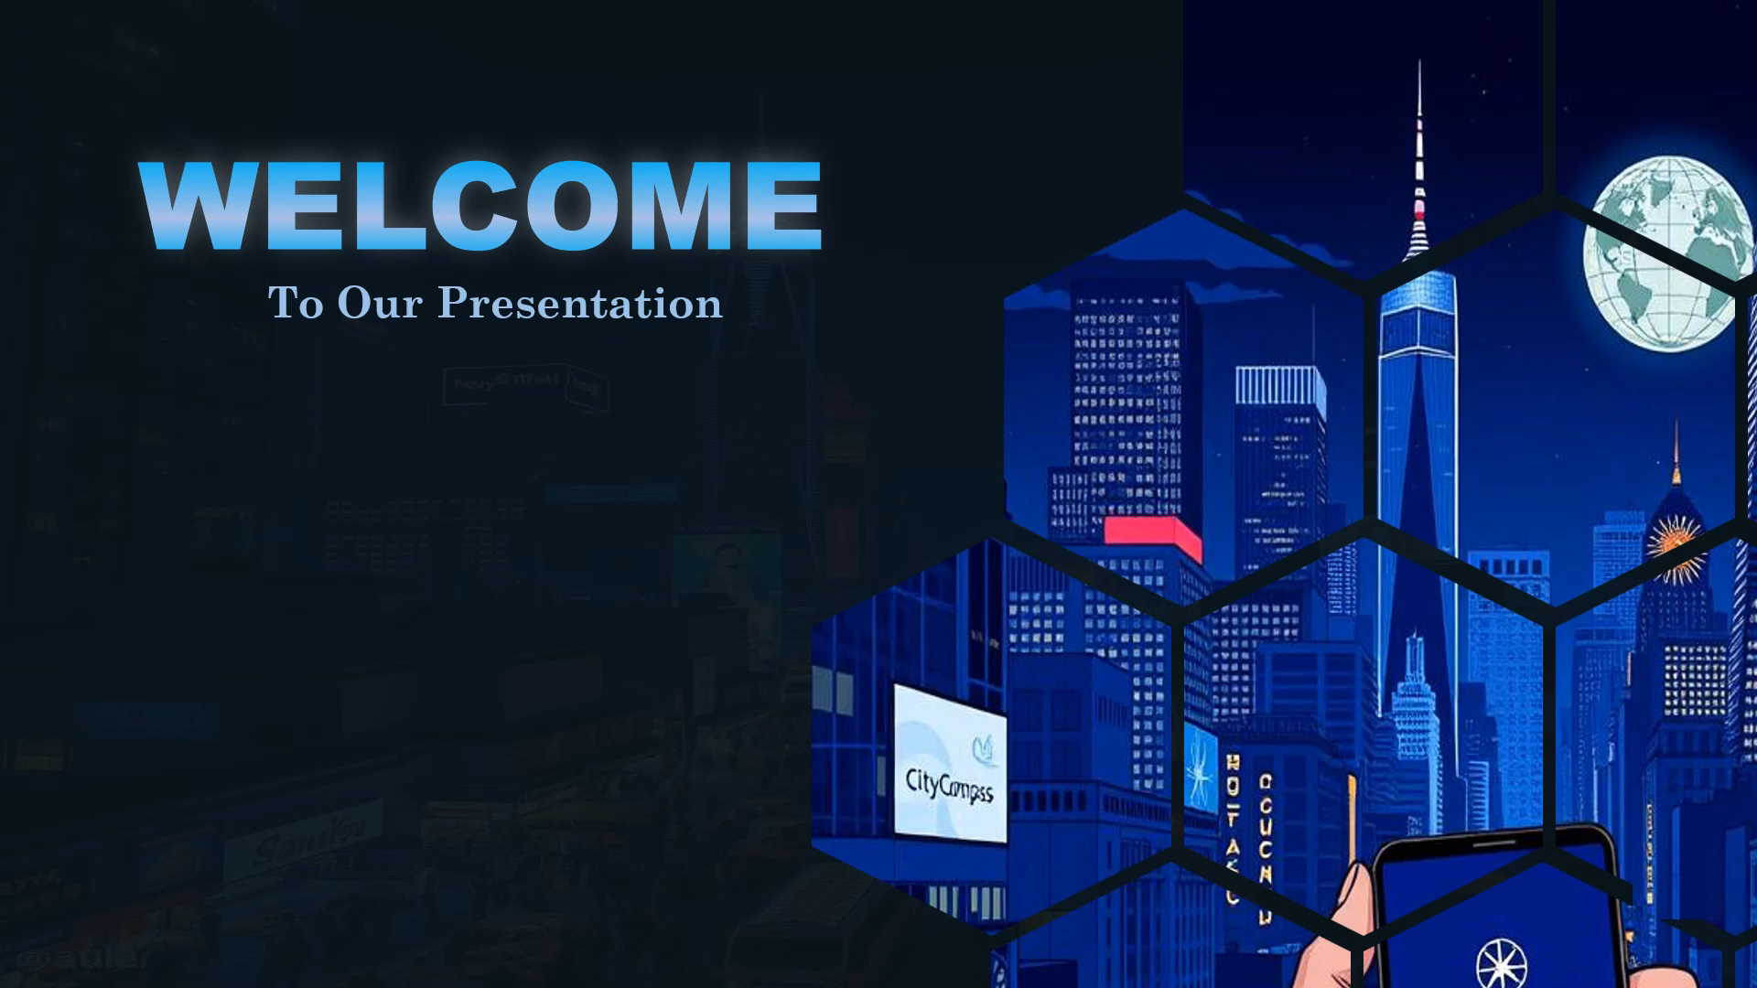
Thank You Everyone
Submitted to :
Mr. Al-Imtiaz Associate Professor & Head, Dept. Of CSE
University of Information Technology & Sciences (UITS)
Propa Punam
Lecturer, Dept. Of CSE
University of Information Technology & Sciences (UITS)
Presented By :
MEHERAB HASAN SABIT
ID : 0432410005101008
JAWAD-UL-KARIM ID : 0432410005101029
ARAFAT RAHMAN ID : 0432410005101030
ATIKA AKTER MITU ID : 0432410005101050

